Slide 1


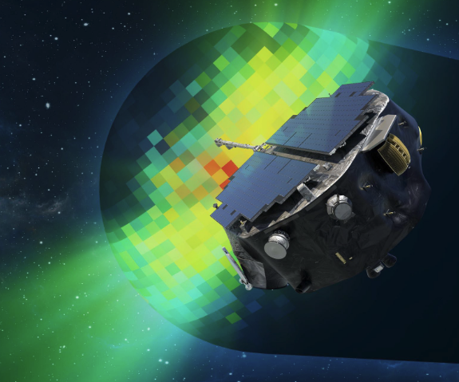
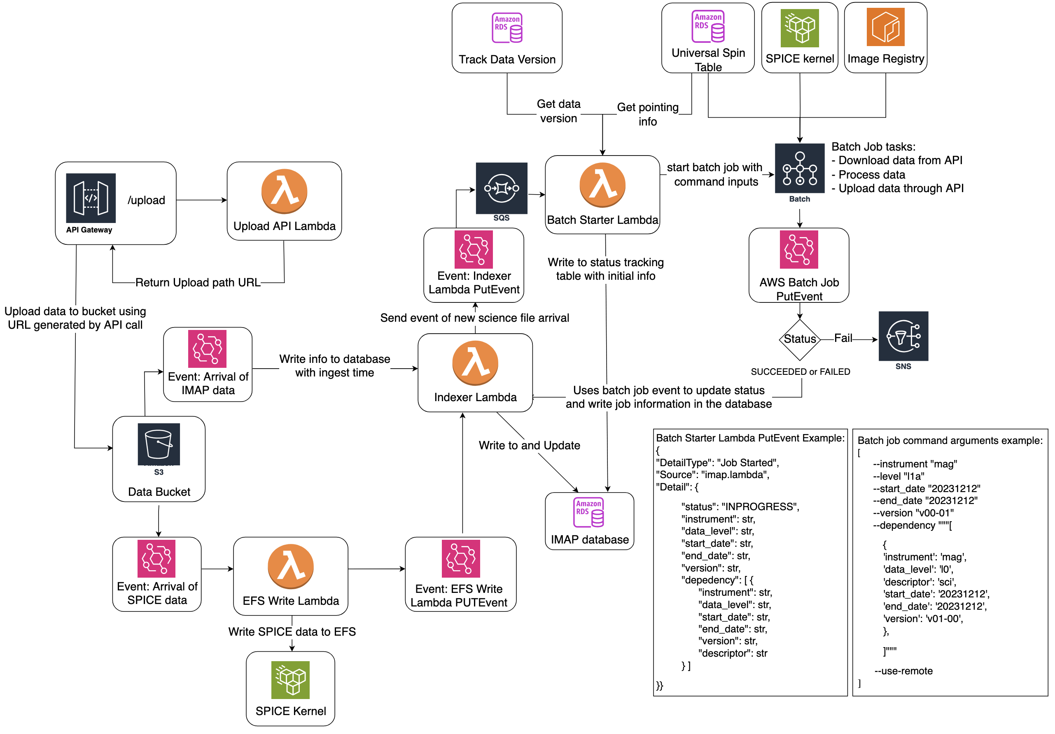
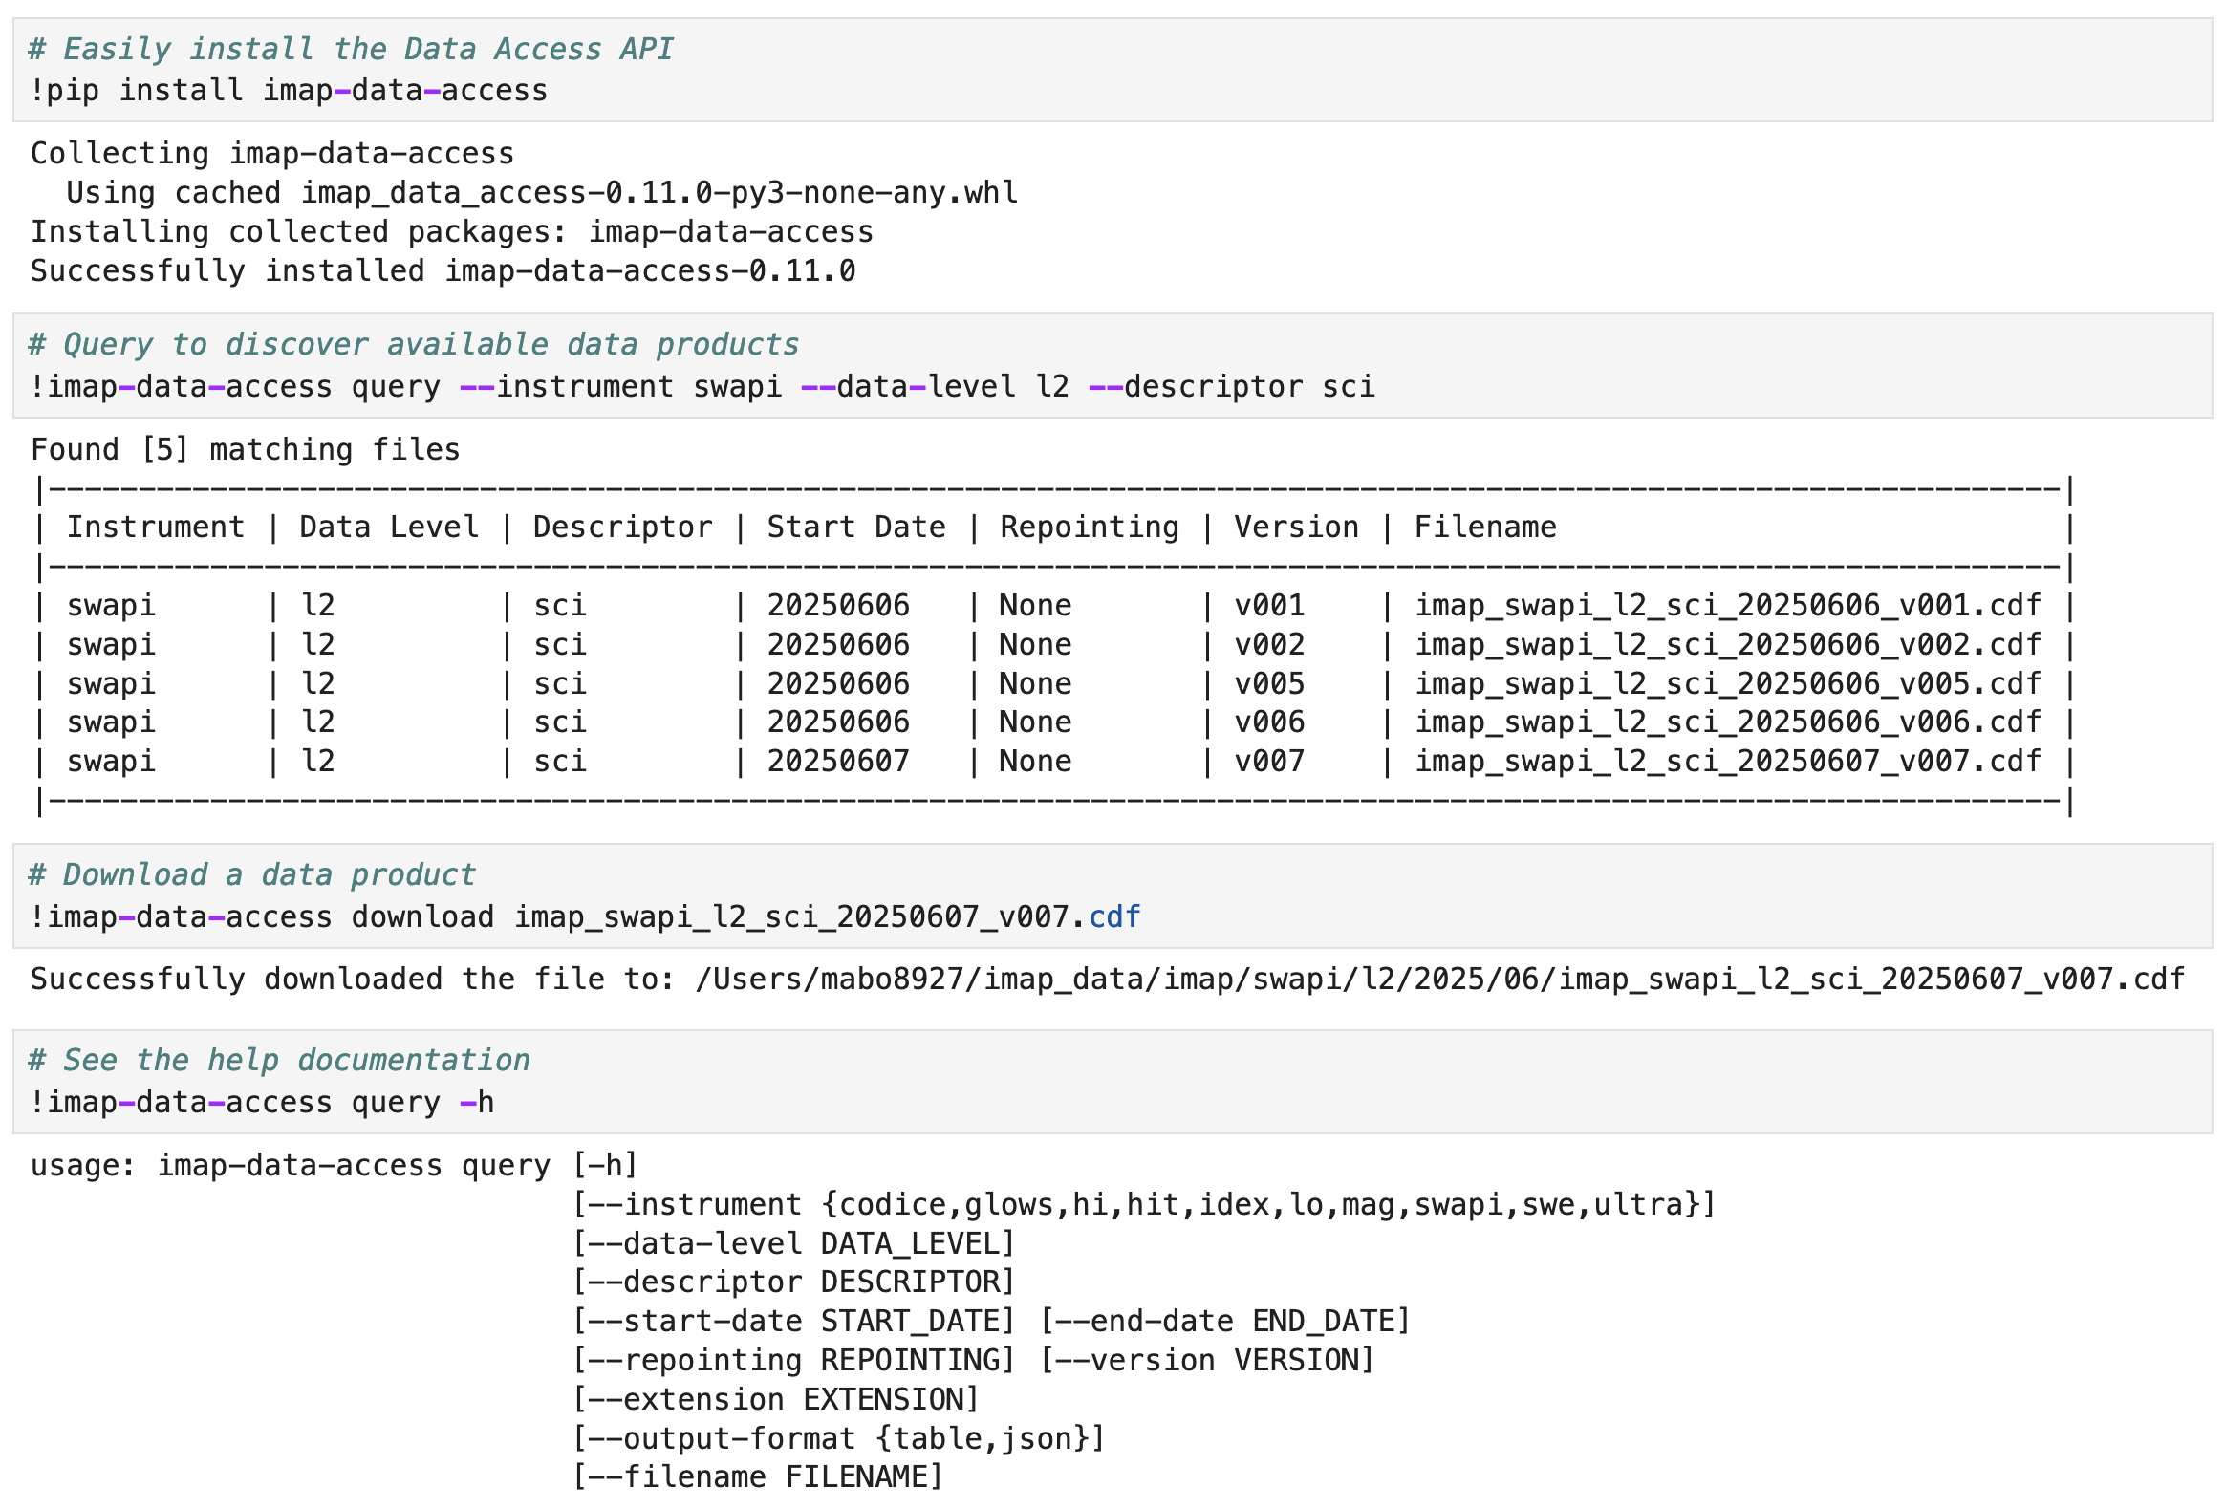
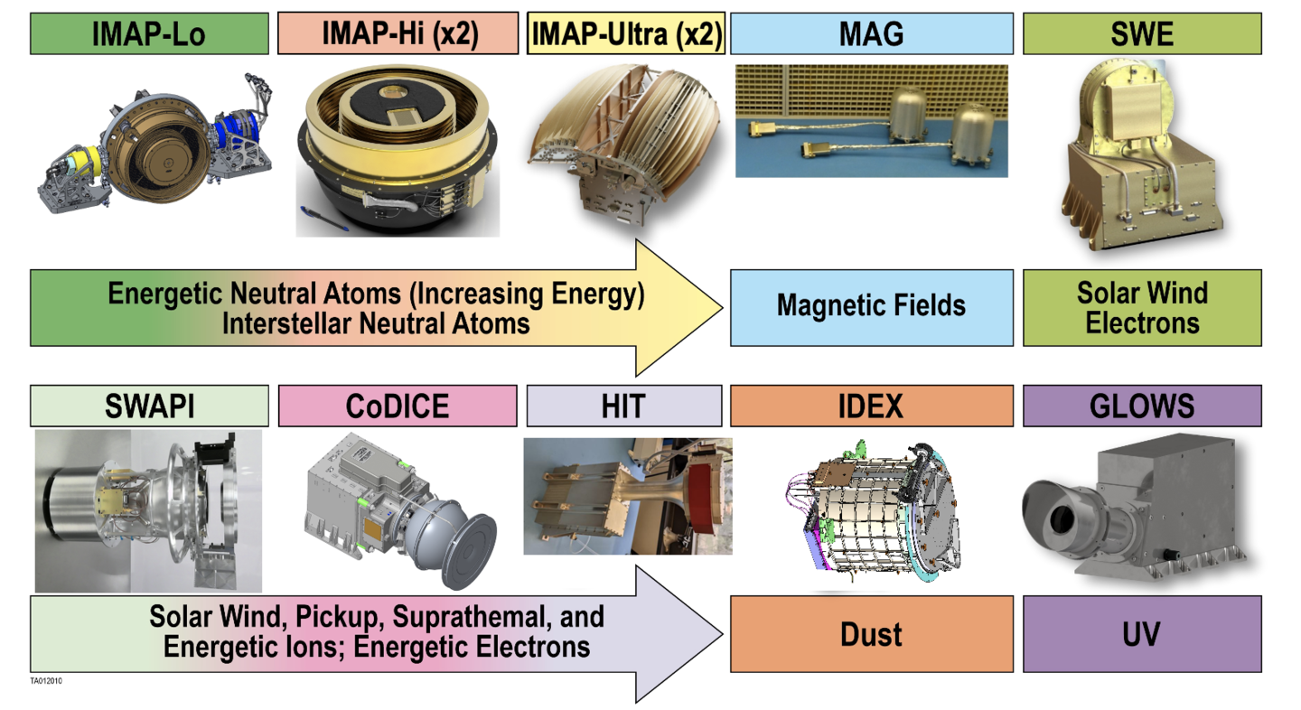
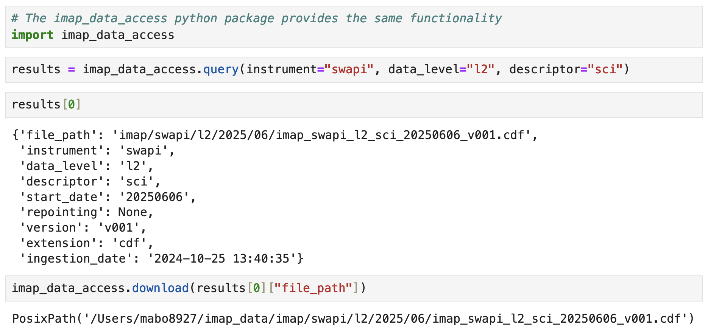
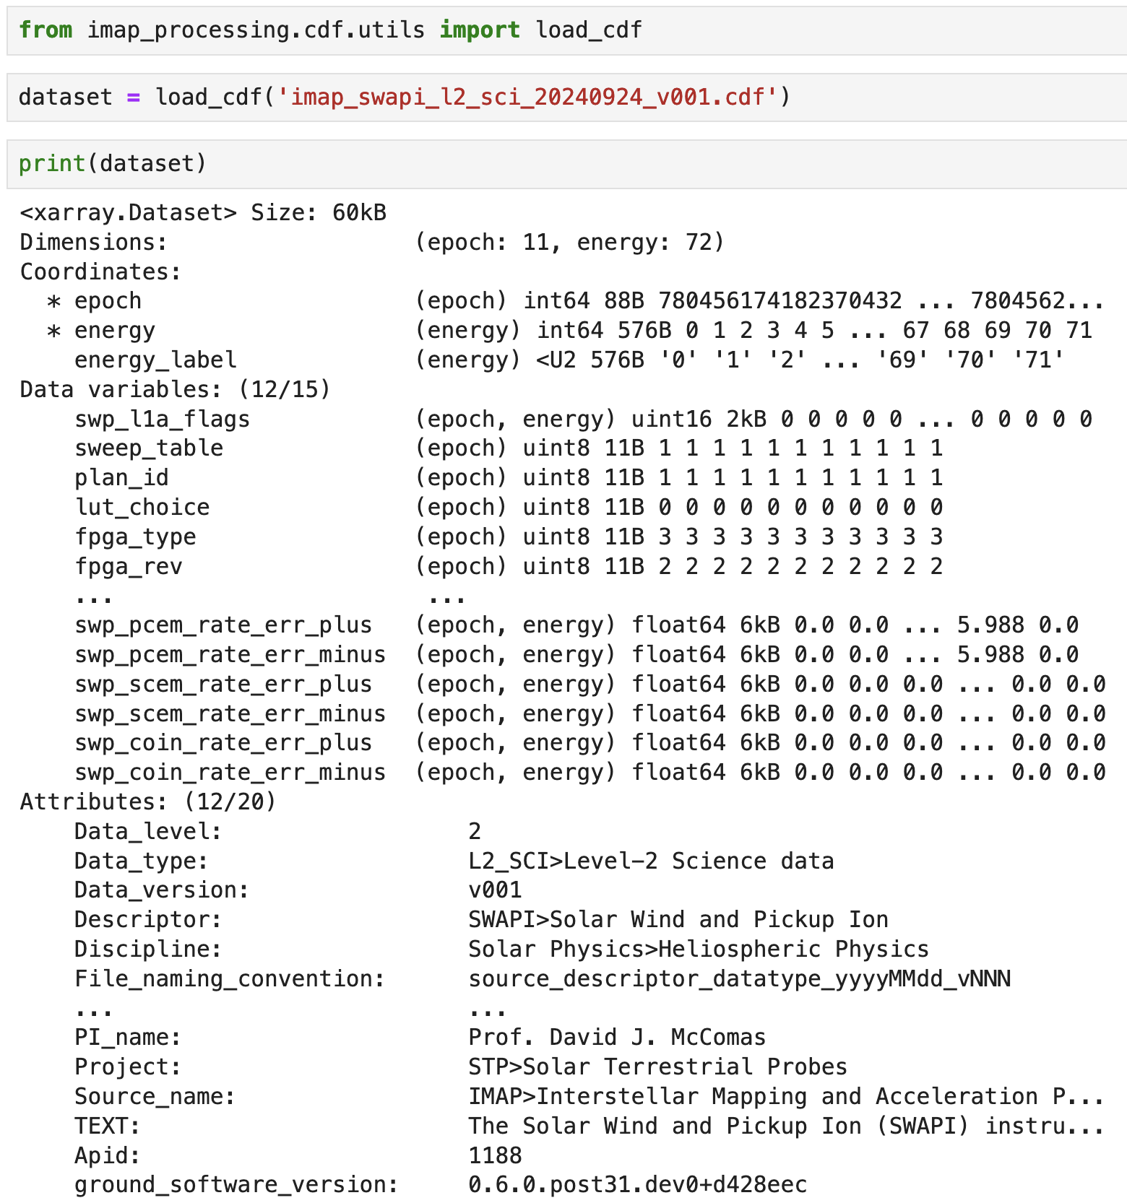
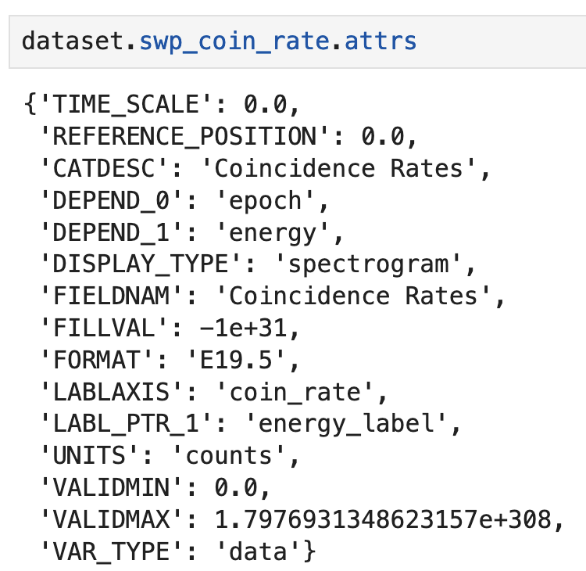
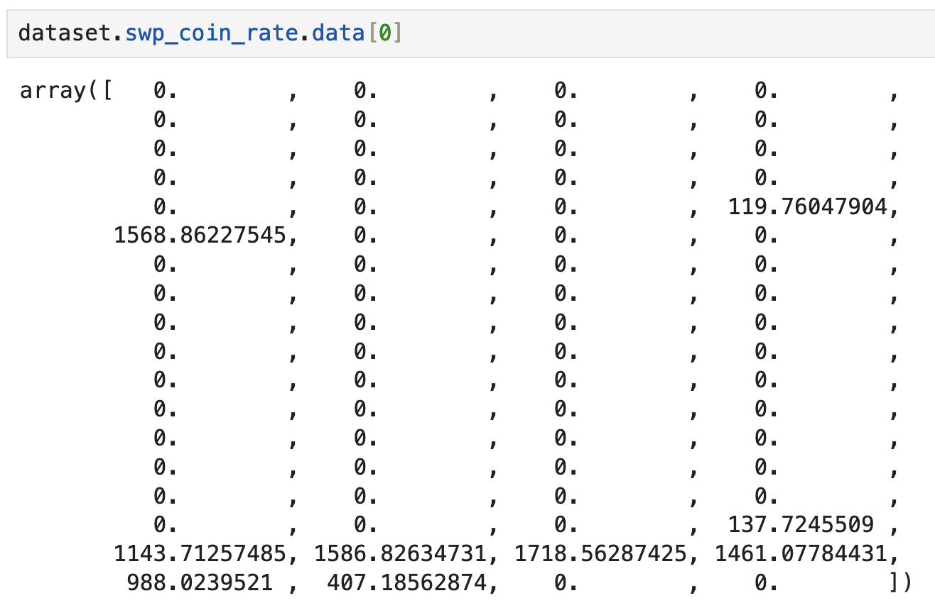






The IMAP Science Data Center: Data Processing and Distribution Through Event-Driven AWS Architecture and Open Science
Matthew Bourque, Tenzin Choedon, Bryan Harter, Maxine Hartnett, Sean Hoyt, Kristopher Larsen, Greg Lucas,
Ana Manica, Veronica Martinez, Gabriel Moraga, Timothy Plummer, Daralynn Rhode, Laura Sandoval The Laboratory for Atmospheric and Space Physics, University of Colorado, Boulder, CO
Poster IN13B-2171
The Interstellar Mapping and Acceleration Probe (IMAP) is NASA's next prominent heliophysics mission. Leveraging an event-driven cloud architecture powered by AWS Batch, ECR, RDS, S3, API Gateway, and EventBridge, the IMAP Science Data Center (SDC) provides a robust data processing pipeline for each of IMAP's ten instruments. A data access API and website provides programmatic and direct access to the SPASE-compliant CDF data products for the heliophysics and space weather research communities. The IMAP SDC embraces open science methodologies and FAIR data principles, promoting transparency, collaboration, and broad data accessibility.
Expected to launch in 2025, IMAP aims to measure the acceleration of energetic particles and map the interaction of the interstellar medium with the heliosphere from its location at Lagrange Point 1. IMAP comprises ten instruments: three Energetic Neutral Atom (ENA) detectors (IMAP-Lo, IMAP-Hi, IMAP-Ultra), four charged particle detectors (SWE, SWAPI, CoDICE, HIT), a UV photometer (GLOWS), a magnetometer (MAG), and a dust analyzer (IDEX). Additionally, the IMAP Active Link for Real-Time (I-ALiRT) data pipeline provides continuous space weather data on a five-minute latency.
The Interstellar Mapping and Acceleration Probe
Event-Driven Data Processing
Data Access
Expected to launch in 2025, IMAP will uncover new insights into the composition and properties of the local interstellar medium and its interactions with the solar magnetic field, the dynamics of solar wind at the heliosphere’s boundaries, and the mechanisms of particle acceleration to high energies across the solar system. This will be accomplished through the comprehensive suite of ten instruments (pictured below).
The SDC employs an event-driven AWS architecture to process L0 data files uploaded to an S3 bucket, automatically triggering the creation of higher-level data products. The system manages dependencies, logs processing steps, and stores completed Level 1 and 2 data products in the S3 bucket.
Users can programmatically search for and download IMAP data via the open-source imap-data-access command-line utility and Python package, demonstrated above. Users will also be able to directly access data through the forthcoming SDC website, which will provide an intuitive interface for browsing and downloading datasets.
Data Format
High Level Data Products
The IMAP Science Data Center
CoDICE | Intensities, abundances, charge state ratios/distributions, ion speed/mass, pitch angle distributions
GLOWS | Daily helioglow-intensity lightcurves
HIT | Livetime-corrected standard, sectored, and summed fluxes, spectrograms
IDEX | Rate, flux, and composition maps
IMAP-Hi | 1- and 80-AU flux maps, ENA spectral index maps
IMAP-Lo | ENA and ISN fluxes, 1 AU ENA flux maps, ENA spectra
IMAP-Ultra | Survival corrected flux maps, 1 AU flux maps, spectral index maps
MAG | Normal- and burst-rate magnetic field vectors
SWAPI | Combined differential flux of SW H+, He++, and interstellar H+, He+ Pickup Ions
SWE | 3D distribution of electrons binned by energy and angle
The IMAP SDC builds and maintains software systems that process, store, and distribute the mission’s science data. Its key responsibilities include:
Receiving Level 0 science, housekeeping, ancillary, and SPICE¹ data from the Payload Operations Center (POC)
Developing Level 1 and 2 processing pipelines to generate data products and making them available to instrument teams within 24 hours
Assist in the collaborative development of higher-level data products (i.e., Level 3, quicklook plots, and other visualizations)
Deliver SPASE²- and ISTP³-compliant data product files to the SPDF⁴ during the mission for long-term archiving
Package a subset of data across the CoDICE, HIT, MAG, SWAPI, and SWE instruments into an I-ALiRT⁵ data product with a 5-minute latency
Provide open access to all software and data in alignment with open science guidelines and FAIR⁶ data principles
Data are stored in files using the Common Data Format (CDF). Each file contains global attributes that store mission- and instrument-specific metadata, as well as data variables containing multidimensional Numpy arrays of data values, each with their own set of self-describing metadata attributes. The CDF files can be seamlessly loaded into Python Xarray objects, facilitating access and analysis of the data.
¹Spacecraft, Planet, Instrument, C-matrix, Events; ²Space Physics Archive Search and Extract; ³International Solar-Terrestrial Program ; ⁴Space Physics Data Facility; ⁵IMAP Active Link for Real Time; ⁶Findable, Accessible, Interoperable, and Reusable
This table lists some of the expected Level 2 and 3 data products for each of the ten instruments (subject to change).
Useful Links:
IMAP Mission Website: https://imap.princeton.edu/
Visit us on GitHub! https://github.com/IMAP-Science-Operations-Center
IMAP SDC Documentation: https://imap-processing.readthedocs.io
IMAP SDC Website (forthcoming): https://imap-mission.com/
Data Access API: https://github.com/IMAP-Science-Operations-Center/imap-data-access
Missions supported by LASP: https://lasp.colorado.edu/our-legacy/missions/

